Slide 1
A Pilot Data Analysis of Hotness in Online Deals Data
By: Trelan Barron

Slide 2
Overview
Introduction
Research
Results
Summary
Conclusion

Slide 3
Overvirew
Perform exploratory data analysis on the deals data
find out the distribution of deals in each category and aggregate the sum of deals in each category
Find out the hotness distribution
Look for factors may affect the hotness of deals

Slide 4

Introduction

Slide 5
Deals
A period during which a retailer sells goods at reduced prices
A target customer
The goal is to reach out to leads who have shown interest or fit the description of their target customer

Slide 6
Companies and Data
What affects if a deal trends or not?
How do companies use data to their advantage when it comes to deals data?
How does this data help the company as a whole?

Slide 7

Research

Slide 8
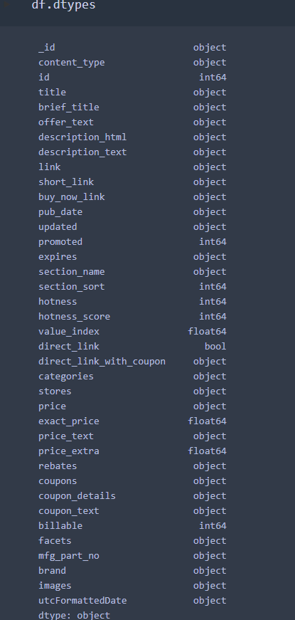
Exploratory Data Analysis
Data Types
Understand and manipulate the data
Good for further analysis

Slide 9
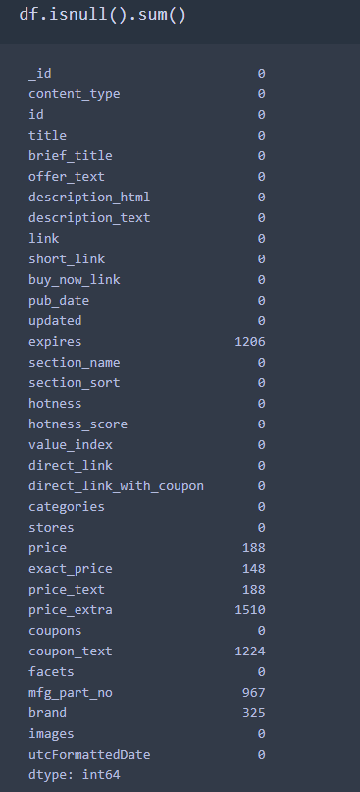
Exploratory Data Analysis
Missing Data for each variable
See which variables need to be dropped
Fill in missing values

Slide 10
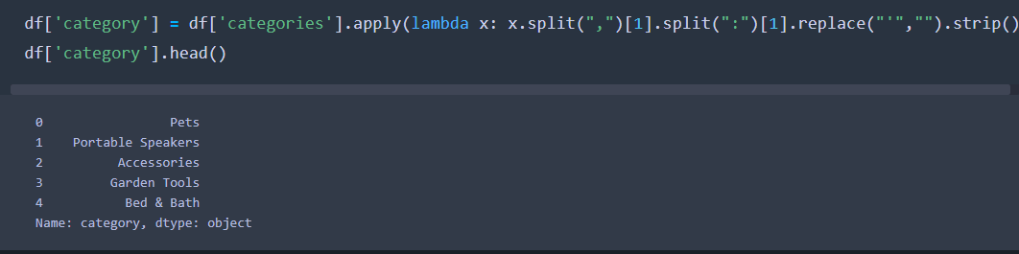
Exploratory Data Analysis
Categories variable
Allows me to get ready to aggregate the sum
Helps with keeping track of the data by organizing it

Slide 11


Slide 12
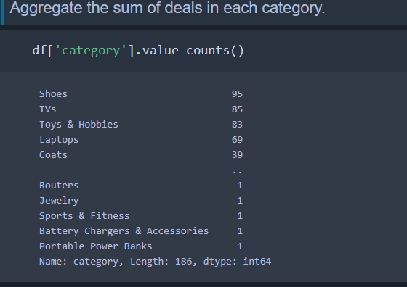
Results
Aggregate sum of deals in each category
Shows the highest category from ascending to descending
Shoes has the highest sum of deals

Slide 13
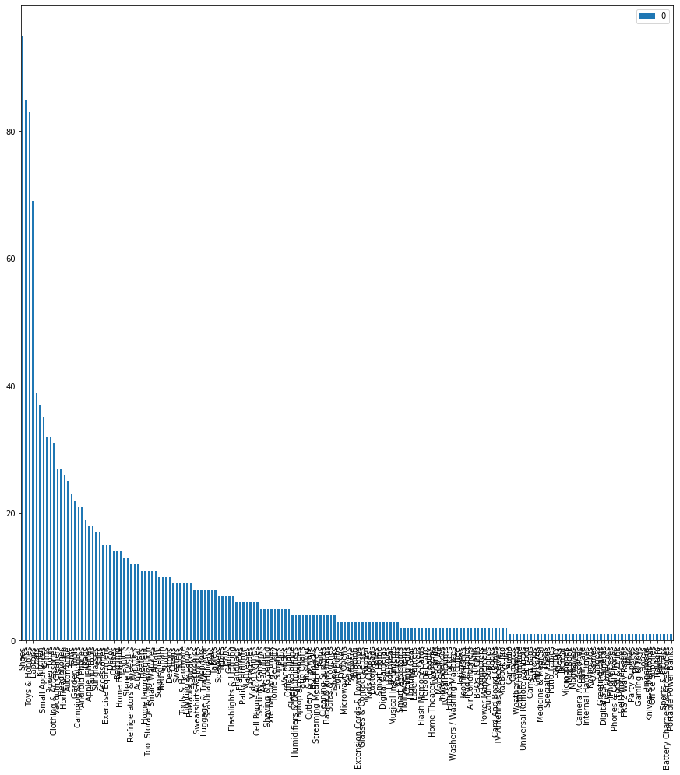
Results

Slide 14
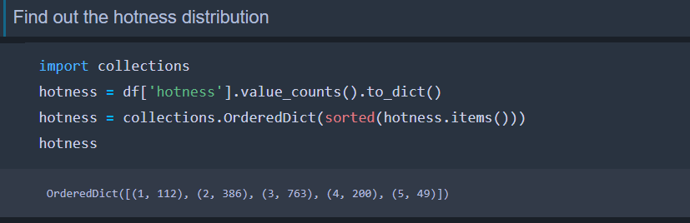
Results
Broke down hotness into dictionaries
Sorted and collected
Looks like 3 has the highest number of distribution

Slide 15
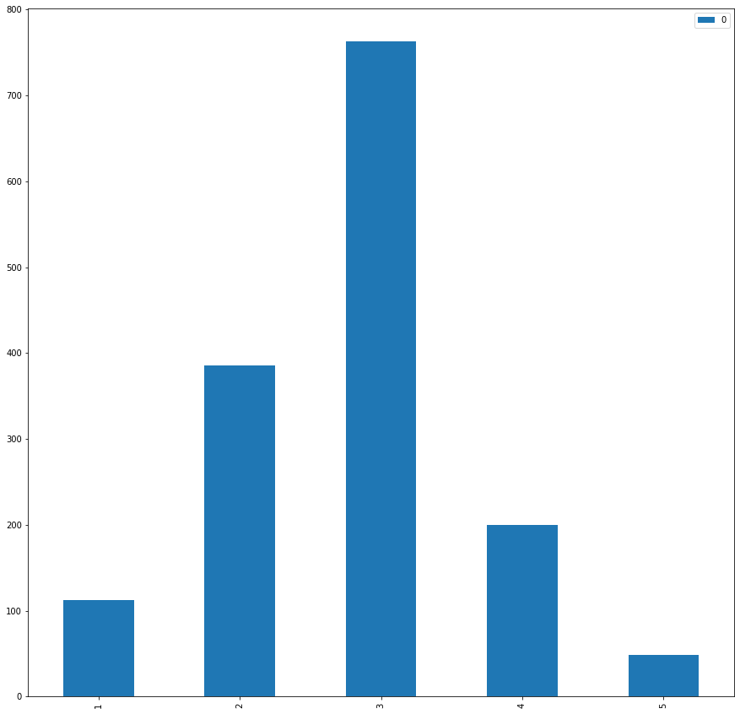
Results

Slide 16
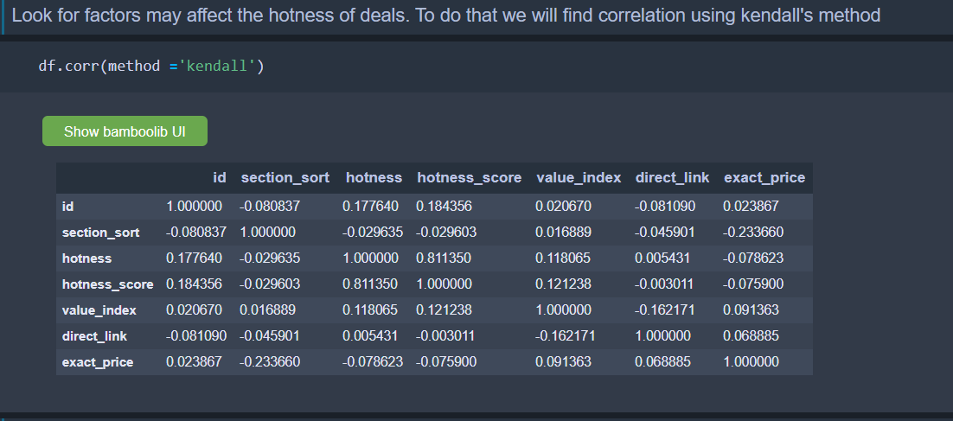
Results
Hotness_score
Value_index
Exact_price
Section_sort

Slide 17
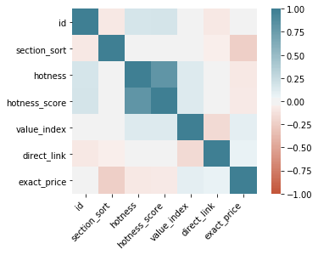
Results
Positive correlation is good due to it predictive power. If two variables are correlated, we can use the value of an item on one variable to predict the value on another
Negative Correlated variables will typically not help with predictions later on

Slide 18


Slide 19
Summary
Performed Exploratory Data Analysis on deals data
Shoes had the highest sum of deals
Hotness of 3 had the highest distribution
Hotness_score has highest correlation to Hotness

Slide 20


Slide 21
Conclusion
Machine Learning
Predictive model for Company
Gain useful insights from Data
Help Company make objective Decisions

Slide 22

Questions?

